Slide 1
Object serialization & deserialization

Slide 2
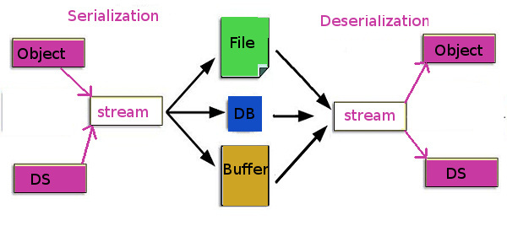

Slide 3
Object serialization & deserialization in C++
Serialization is the mechanism of converting an object’s state into a byte stream
Deserialization is the reverse process: byte stream is used to recreate the actual object
This serialization mechanism is used to persist the object
The byte stream created is Platform Independent
Hence, a serialized object can be de-serialized on any other platform.
Serialization in C++

Slide 4
Object serialization & deserialization in Java
In JAVA, to make a JAVA object serializable we have to implement the java.io.Serializable interface
The ObjectOutputStream class contains writeObject() method for serializing an object.
public final void writeObject( Object obj ) throws IOException
The ObjectInputStream class contains readObject() method for deserializing an object.
public final Object readObject( ) throws IOException, ClassNotFoundException

Slide 5
Serialization in JAVA
Serialization in JAVA of only non-static members
Object has been serialized
Data before Deserialization.
name = ab
age = 20
a = 2
b = 1000
Object has been deserialized
Data after Deserialization.
name = ab
age = 20
a = 0
b = 2000

Slide 6
NOTE :
If a parent class has implemented Serializable interface then child class doesn’t need to implement it but vice-versa is not true.
Only non-static data members are saved via Serialization process (i.e. only Instance members can be Serialized)
Static data members and transient data members are not saved via Serialization process. So, if you don’t want to save value of a non-static data member then make it transient.
Constructor for object is never called when an object is deserialized.

Slide 7
Random Access File

Slide 8
Random access is more precisely and more generally called as direct access)
It is typically contrasted to sequential access
In data structures, direct access implies the ability to access any entry in a list in constant time (irrespective of its position in the list and of list's size).
Very few data structures can guarantee this, other than arrays (and other related structures like dynamic arrays)
Other data structures, such as linked lists, sacrifice direct access to permit efficient inserts

Slide 9
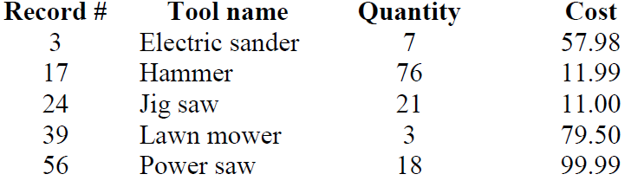
You are the owner of a hardware store and need to keep an inventory, so that you can tell what different tools you have, how many of each you have in hand and the cost of each one. Write a program that initializes the random-access file hardware.dat to 100 empty records, lets you input the data concerning each tool, enables you to list all your tools, lets you delete a record for a tool that you no longer have and lets you update any information in the file.
Random Access File

